Slide 1
Voice Controlled
Shower
By:
James Perez Jessica Diaz
Cory Longshore Hugo Simon

Slide 2
Introduction - Statement of Design Problem
Our goal is to design a voice controlled shower that is able to assist anyone that suffers from limited mobility or has any type of restriction of movement.
The design of our shower is to be voice enabled through the use of an Alexa as well as an optional control through an app.
We want to include functions to adjust the position of the shower head, change the temperature of the water, and have user recognition to enable custom presets for each user.

Slide 3
Inspiration for Project
Our inspiration for this project came from an ALS patient who suffers from a progressive neurodegenerative disease that affects nerve cells in the brain and the spinal cord. This causes diminishing motor functions and limits mobility which requires the need for constant assistance.
This inspired our design to try and improve the quality of life for anyone that requires assistance to do simple tasks, such as taking a shower. Our goal is to have the voice controls assist the user and remove the need for any additional help while showering. This would be beneficial for the elderly or anyone with disabilities that restricts their motor functions.

Slide 4
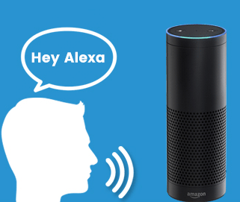
Design Goals
Our goal is to implement:
Voice Commands using an Alexa
Adjustable shower head
Temperature Control & Sensor
User/Facial Recognition
Custom User Presets
Turn on the
shower

Slide 5
Methods to Achieve Design Goals
Voice Commands:
Adjustable Shower Head:
Temperature Control:
User/Facial Recognition:
Amazon Echo will enable hands-free control our device using Amazon’s AI (Alexa)
Motorized track to adjust the position of the shower head which will interface with Alexa through the use of an Arduino that controls the stepper motors
Electric solenoid valves controlled by an Arduino to adjust the ratio of hot and cold water supplied to the shower and a sensor to provide a temperature readout
An external camera for facial recognition to identify the user and load a custom preset for each user

Slide 6
Contributions
https://www.microcontroller-project.com/nodemcu-esp8266-stepper-motor-interfacing.html
https://www.novaspirit.com/2017/07/01/diy-motorized-wifi-camera-slider/
Combined parts of both sets of code and used as a reference for building our webpage, functions, as well as schematics for our circuit. We changed the color of our webpage buttons, added more functions to stop the motor once it has reached the bounds of the track. Additionally, we will be implementing this with Amazon Alexa.

Slide 7
Experimentation/Design Alternatives
Articulating shower head - too bulky/complicated to implement in a confined space while preventing water damage to electronics
Motorized slider to mount shower head for easier movement and control over positioning
Adjusting the Water Temperature -
Started with pumps to adjust the hot/cold ratio of water but decided to use flow control valves to provide more efficient way for user access to changing the temperature

Slide 8
Problems Encountered
Design of the slider to move the shower head
We went through a couple different designs on how to best implement the movement of the shower head and settled with a modified camera slider
Integrating Arduino with Amazon’s web service using AWS Lambda
We had to upload our code to AWS so that we could publish the code to interface with Alexa
Schematic for the motors was incorrect
We had to do more research on the motor itself to find a procedure that would operate them correctly

Slide 9
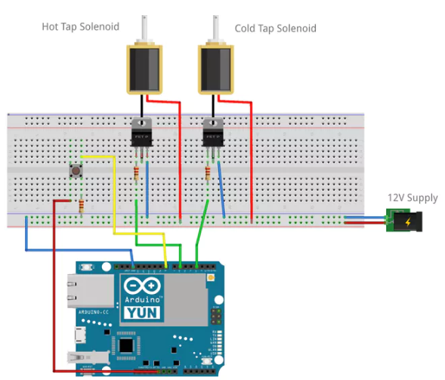
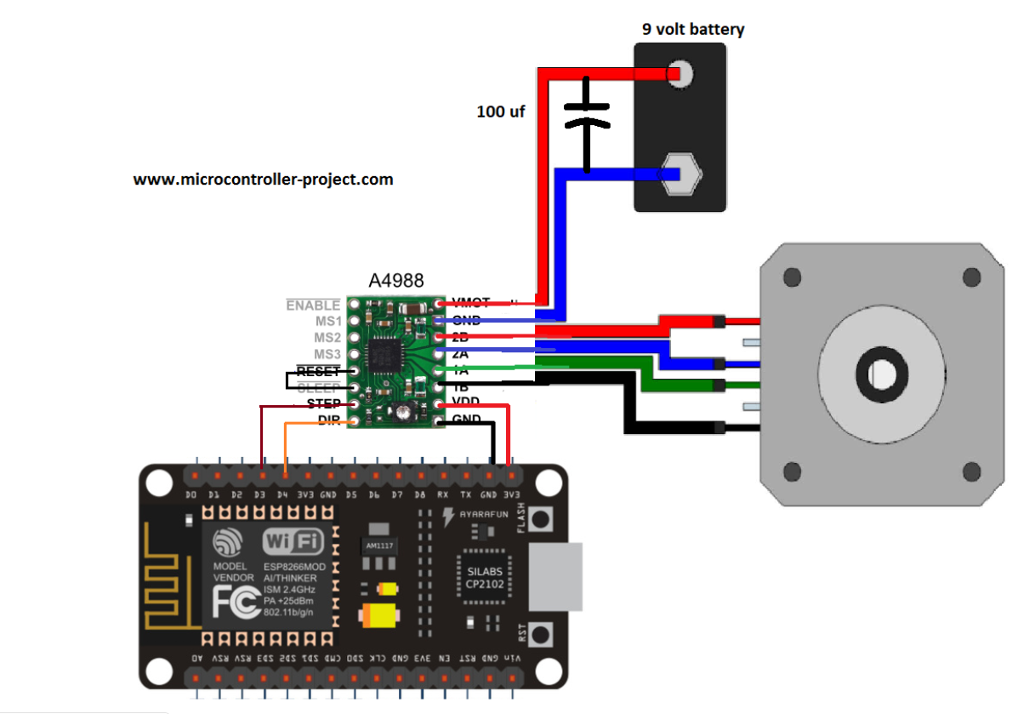
Schematic
Will be using 12V + 47𝞵f instead
of 9V + 100 𝞵f capacitor.
D Design for the flow control valves to adjust the temperature.

Slide 10
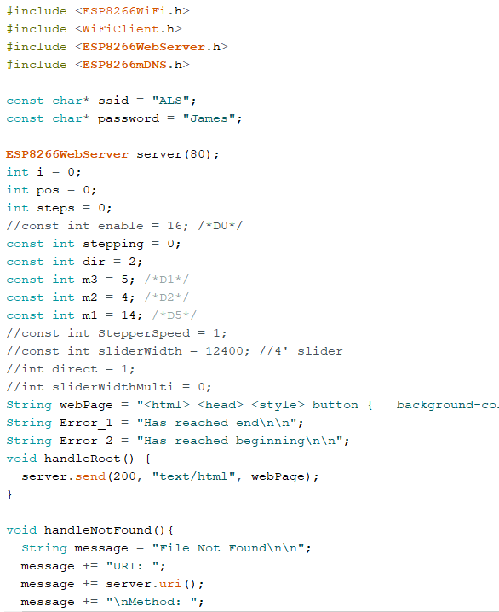
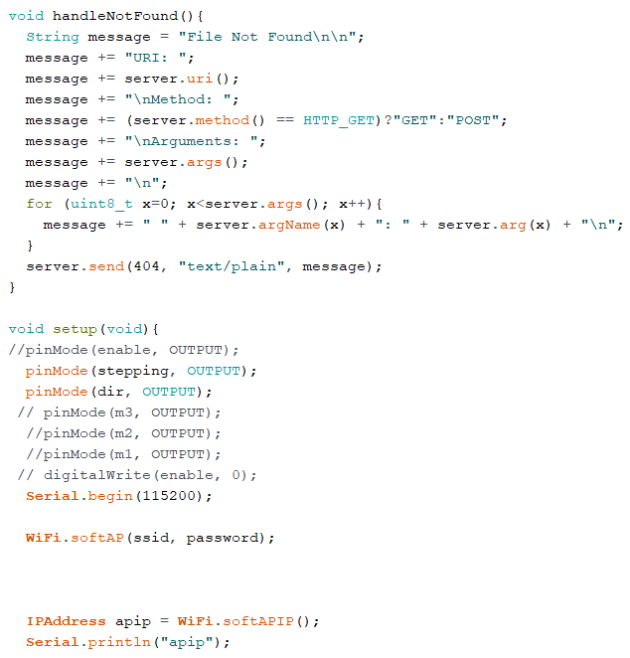
Code

Slide 11
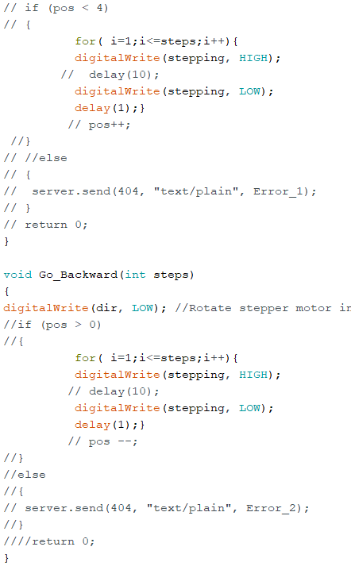
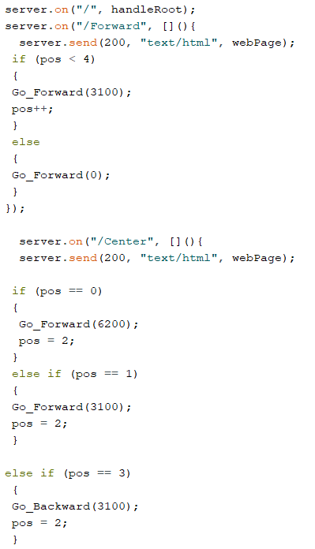
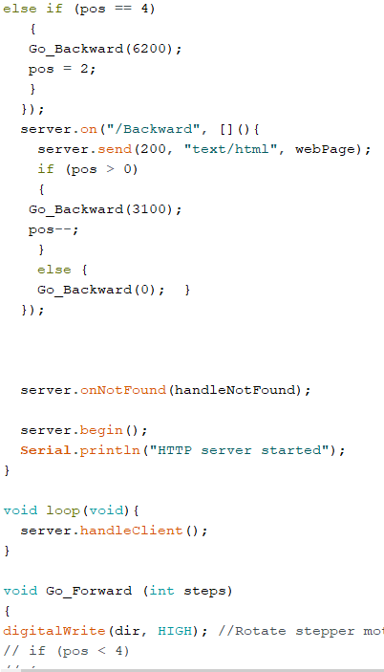
Code

Slide 12
Webpage Code

Slide 13
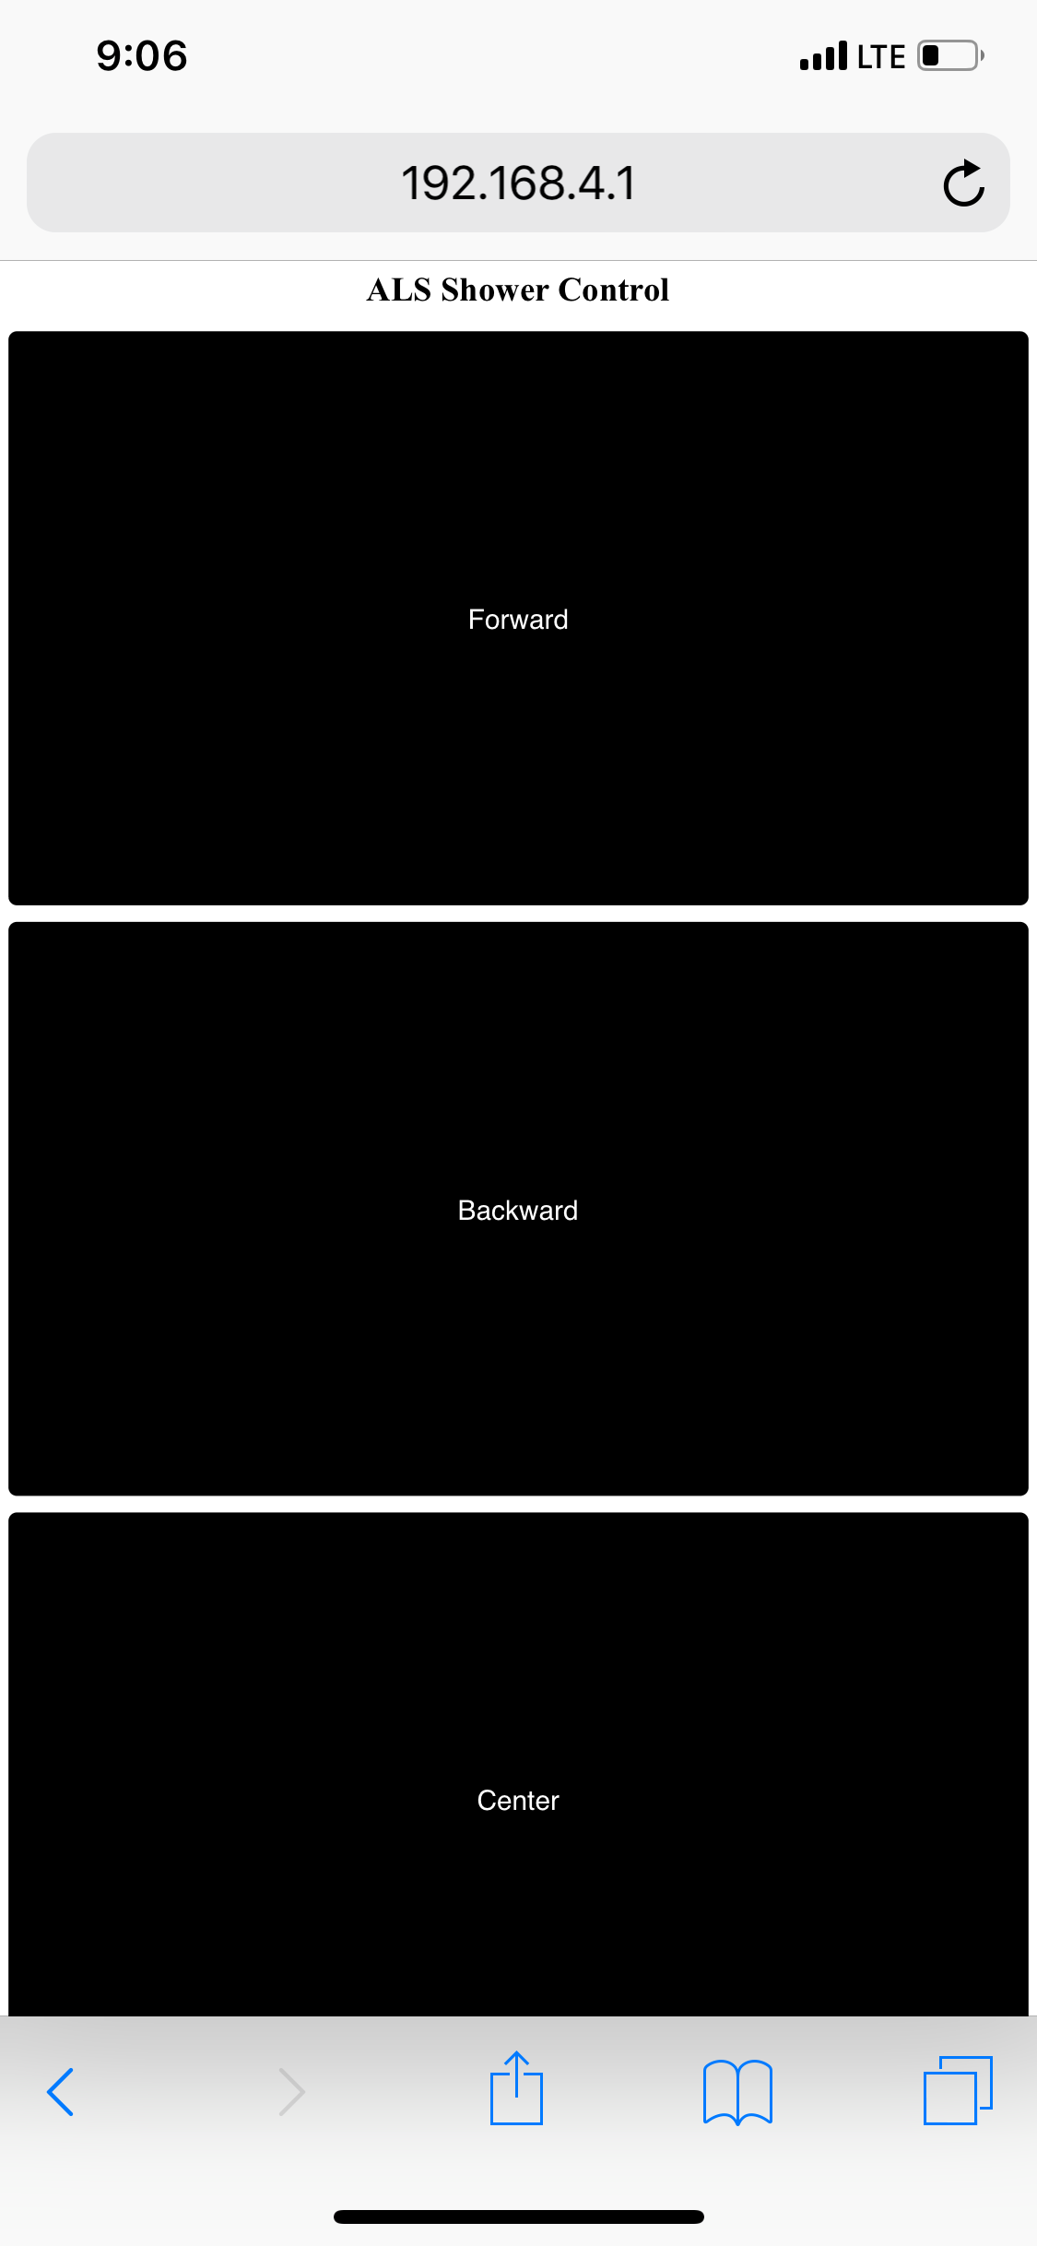
Webpage
Currently, we have 3 buttons:
FORWARD: 3100 Steps or 1’
BACKWARD: 3100 Steps or 1’
CENTER: 3100/6200 Steps,
depending on position.

Slide 14
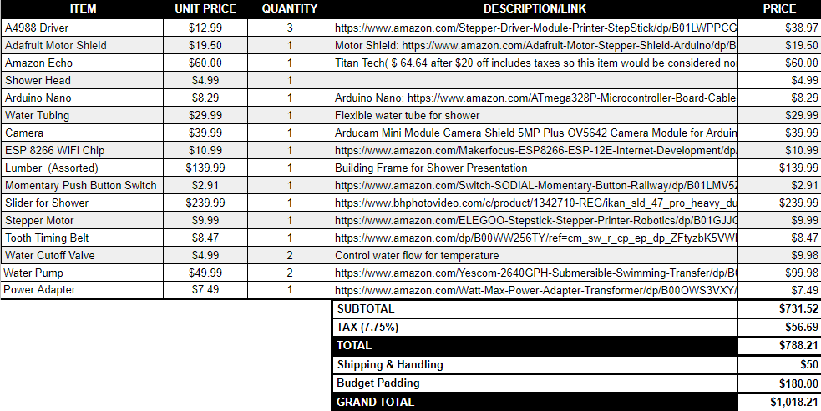
Cost Analysis (Preliminary Budget)

Slide 15
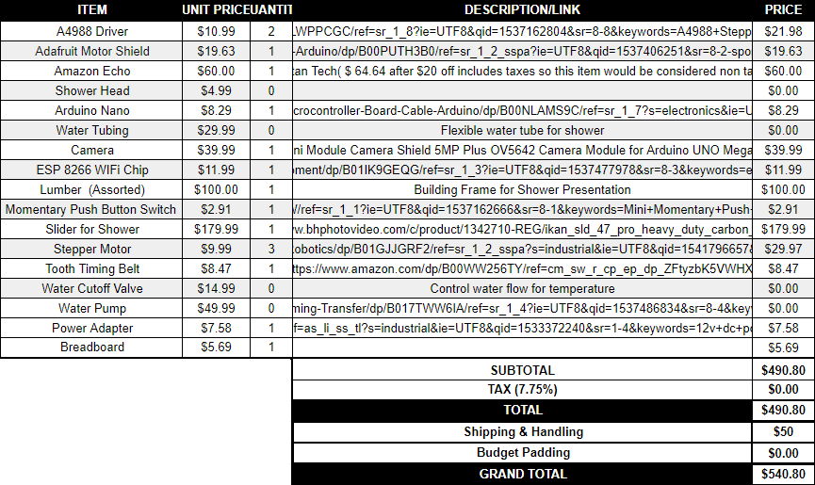
Current Costs

Slide 16
Conclusion
We are currently working on getting the Arduino interfaced with AWS Lambda so that we can start to write the code to configure the voice commands
Once we get the Arduino’s connected with the Echo device, we will install the parts onto our shower frame and start running tests and diagnosing any issues that arise
After the shower movement is tuned, we will start working on installing the flow control valves to adjust the temperature and install the sensor to provide a temperature readout for the user

